Slide 1



Power Sensitive and Context Aware
Global Positioning System
Official Use Only
University of Utah Engineering Clinic 2009-10
September 3, 2009
Steven Paradise
Adrian Wong
Patrick Schindler
OFFICIAL USE ONLY
May be exempt from public release under the Freedom of Information Act
(5 U.S.C. 522), exemption number and category:
Department of Energy review required before public release.
Name/Org Name: Adrian Wong / 8226 Date: September 4, 2008
Guidance (if applicable):
Sandia is a multiprogram laboratory operated by Sandia Corporation, a Lockheed Martin Company,
for the United States Department of Energy’s National Nuclear Security Administration
under contract DE-AC04-94AL85000.
Official Use Only

Slide 2
Overview
Official Use Only
Project Motivation
  Concept Study of Extreme Low Power Consumption Context Aware GPS Receiver with Software Processing
Areas of Study
  RF hardware miniaturization and integration
  Context aware power management for low consumption
  Very short duration GPS snapshot acquisition
  Incomplete GPS fragment navigation
  Cross platform GNSS operation (GPS, Galileo)
Project Requirements
  Target Platform: Sandia Stack Architecture
  Time Constraint: March 25, 2010

Slide 3
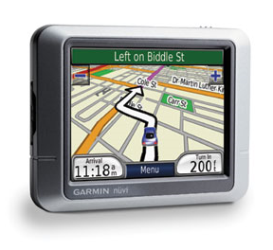
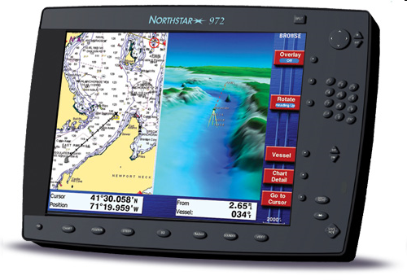
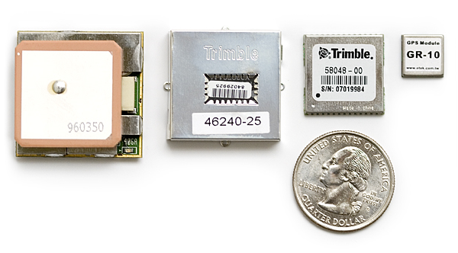
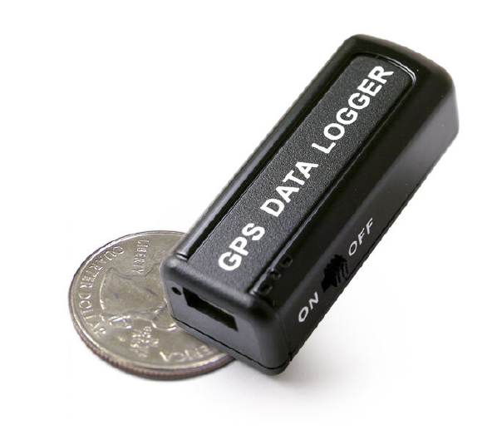
GPS Receivers
Notes:
Commercial GPS navigation devices are widely available today. These units come with mapping features, large LCD displays, and turn-by-turn navigation. The Garmin nuvi on the upper left is an example of a commerically available GPS navigation device. These are all great features but, at its heart, the unit is still a GPS receiver. If you strip away all the extraneous parts, you arrive at the core of the system, a GPS receiver. The GPS receiver takes an RF signal from an antenna, performs some signal processing and some calculations, and arrives at a latitude, longitude, and altitude. These three data points, along with a velocity vector and very precise timing signal, are the GPS products. To use GPS parlance, your location (lat, long, alt) is known as the navigation solution. The navigation solution can then be sent out to other devices downstream that may use it to overlay charts or calculate routes. One example is an in-car navigation unit, but another is a marine navigation unit on the upper right. But GPS units don’t need displays. On the bottom left is a GPS data logger that simply logs the navigation solution to memory. If we break it down even further, you can see GPS receivers on the bottom right in a variety of form factors. As technology has improved, these receiver modules have gotten smaller and smaller.

Slide 4
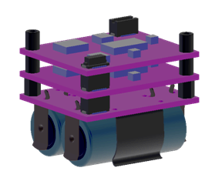
Sandia Project
Objective
Fit a low power GPS receiver to a standardized Sandia stack form factor and log location.
Must run off CR2 batteries
Must log location for weeks
Must interconnect with stack

Slide 5
GPS Receivers
ML-7 GPS Data Logger
Cold Start Acquisition Time: 36 seconds
Power Consumption: 5 V, 30 mA (150 mW)
Trimble Copernicus GPS Receiver
Cold Start Acquisition Time: 39 seconds
Power Consumption: 3.3 V, 28 mA (92 mW)
GR-10 / MN1010 GPS Receiver
Cold Start Acquisition Time: 42 seconds
Power Consumption: 1.8 V, 35 mA (63 mw)
Notes:
Look at the power consumption these devices. The ML-7 data logger is 150 mW, the Copernicus GPS receiver is 92 mW, and the tiny GR-10 on the end is 63 mW. This might not seem like a lot, especially in the domain of consumer electronics, where you can always just go home and charge up the battery at the end of the day.

Slide 6
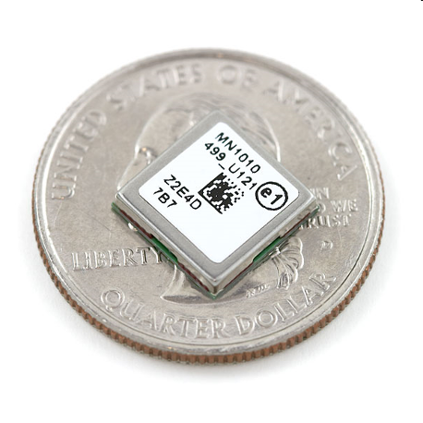

Power Consumption
GR-10 GPS Receiver
  Voltage 1.8 V
  Current 35 mA
  Power 63 mW
  TTFF 42 secs
CR-2 Lithium Battery
  Typical capacity of 800 mAh
System assumptions
  Allow GPS 50% of system power
  Take readings every 15 minutes
  Zero power consumption when off
Operation Lifetime: 10 days
Energy Consumed: 3 J per sample
Continuous operation at 35 mA gives lifetime of 22 hours
Notes:
Let’s take a look at the numbers. Let us assume that you power this device of a lithium CR-2 battery – the kind used in cameras. We will also assume that the GPS unit is allowed 50% of the power budget of the system, we take readings every fifteen minutes, and that there is zero power consumption in between the readings. Even with these extremely generous assumptions, we have an operational lifetime of 10 days. That just is not good enough. We need to reduce the amount of energy consumed by the device by an order of magnitude or more. And just to give you an idea, if we ran just the GPS receiver at 35 mA continuously, the battery would run out of its rated lifetime in 22 hours.

Slide 7
Black Box Approach
GPS
Power
Latitude
Longitude
Altitude
Antenna
Notes:
To reduce the power consumption by two or three orders of magnitude, we have to look beyond the GPS receiver as a black box where power from a battery and an RF signal from an antenna go in and navigation solutions pop out. We need to break this open and understand the underlying concepts and operation of the device to achieve solutions beyond just turning the receiver on and off. So, let’s do it.
I am going to give you a crash course in how GPS works in five minutes. Many of the images and text taken from a variety of sources, most of which are included in your project files on the CD.

Slide 8
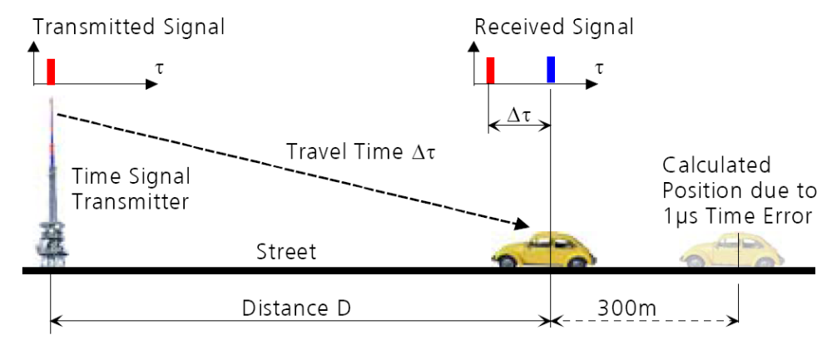
1D Navigation
Measure the travel time from transmitter to receiver
Velocity of the signal is the speed of light
Distance = Velocity x Time
Small errors in Δt can cause large errors in distance
Notes:
The transmitter and the receiver have synchronized clocks. The radio wave propagates at the speed of light (300000 km/s). By measuring the delay from when the signal is transmitted to when it is received, we can calculate our distance. However, juts a small error in the receiver clock will cause a large error in the distance.

Slide 9
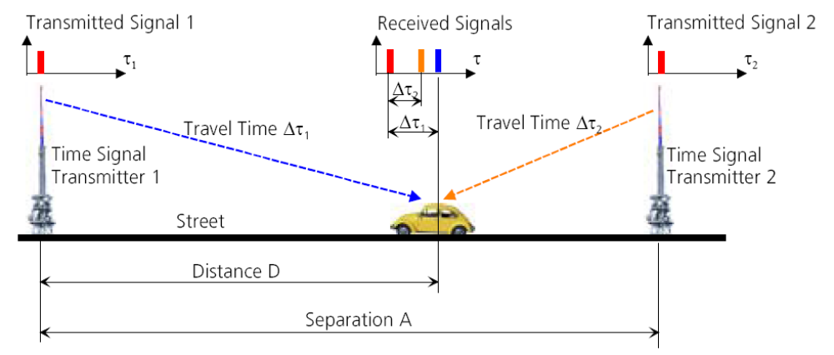
N + 1 for receiver clock offset
Second transmitter can correct for receiver clock offset
1D problem: distance D is unknown, clock offset unknown
System of linear equations with two unknowns
3D problem: three position unknowns + 1 time unknown
To calculate position in 3D, need a minimum of 4 receivers
Notes:
If we had a second transmitter, we can correct for this. Essentially, a system of linear equations with two unknowns in two equations – distance and receiver clock offset. Without getting too bogged down in the details, having an unsynchronized clock is not a problem if we can correct for it by adding one additional transmitter. The example I gave is a 1D problem, so it needs two transmitters. In a 2D problem, you would need three transmitters. And in a 3D problem, like the world we operate in, we would need a minimum of four transmitters.

Slide 10
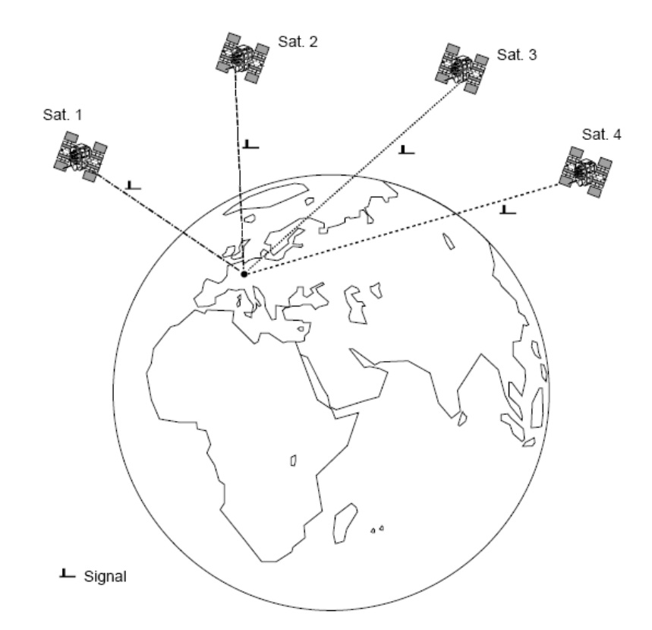
Satellite Navigation
Transmitters are now orbiting satellites with very accurate atomic clocks
Four satellites required
  Latitude
  Longitude
  Altitude
  Receiver clock offset
Notes:
Now, instead of fixed ground transmitters (which did exist at one point as a system known as LORAN), we have orbiting atomic clocks. As before, we have four unknowns, so we need four satellites.

Slide 11
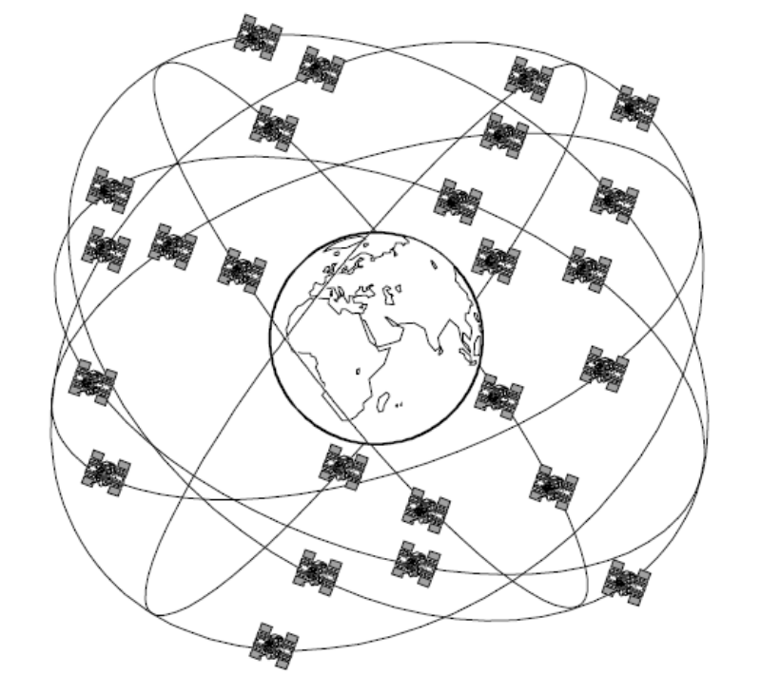
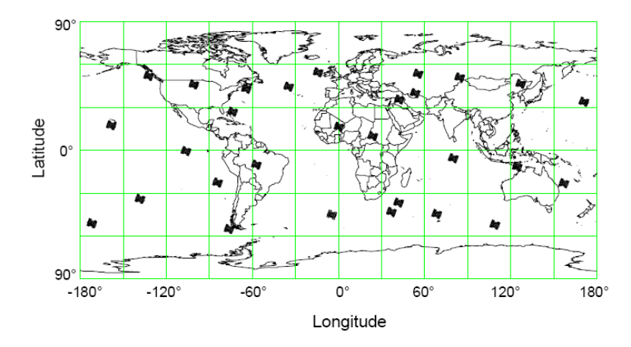
NAVSTAR GPS
NAVSTAR GPS by DoD
  Up to 32 satellites in six orbital planes
  Orbit at 20,000 km
  12 hour orbit
Notes:
The DoD has put up a satellite constellation known as NAVSTAR GPS. There are up to 32 satellites in orbit; they come and go as satellites die or are replenished. But there are enough that a minimum of four are visible at any one time anywhere on the globe.

Slide 12
GPS Signal Structure
All transmit on the L1 frequency (1575.42 MHz)
  CDMA (Code Division Multiple Access)
Modulated with Coarse/Acquisition PRN code
  1023 chips (each chip 1 us), repeats every 1 ms
  Each satellite has a unique C/A code sequence
Data is BPSK at 50 bits per second
Notes:
How do you separate the signals from each satellite? You may be familiar with FDMA or TDMA. You could do frequency division, which is what the Russian navigation system GLONASS uses, or you could do time division, which would likely be a logistical headache. GPS uses neither. In fact, all the GPS satellites transmit on the same frequency of 1.5 GHz all at the same time. How do you tell the signals apart? Using code division multiple access. Each satellite modulates its message with a different pseudorandom noise sequence or PRN. For reasons I won’t go into here, these PRN signals are orthogonal to each other in code space. You can therefore pick out different GPS signals using CDMA. You may also hear of this referred to as Direct Sequence Spread Spectrum (DSSS).

Slide 13
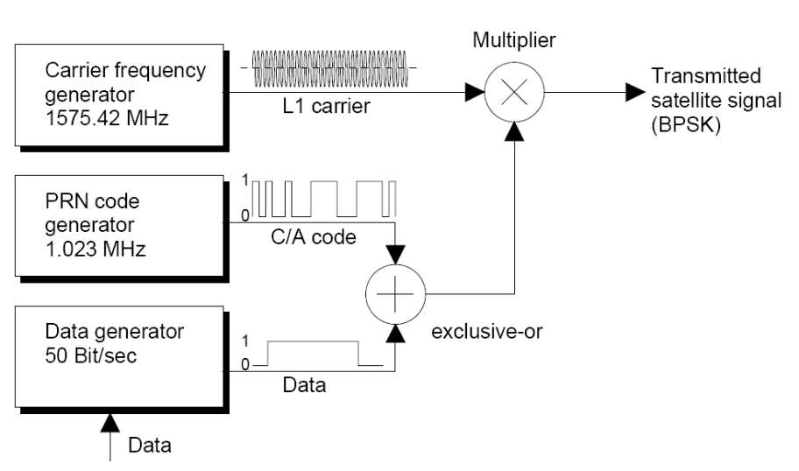
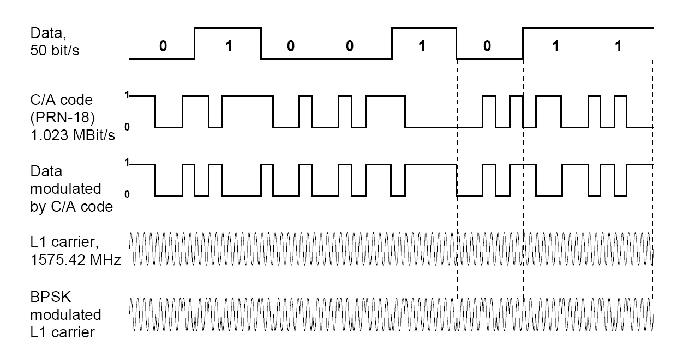
GPS Navigation Message
Notes:
So, to summarize, the satellites need to transmit a message. The message data is modulated by the C/A code. The result is multiplied with the L1 carrier to send out a BPSK (binary phase-shift keying) message.

Slide 14
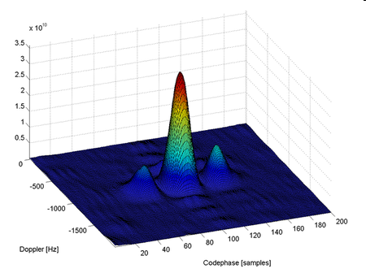
GPS Satellite Acquisition
PRN sequences are known to the receiver
  Correlate the incoming signal with the 32 known PRN to find sat
Satellites flying around the Earth at 14,000 km/hr!
  Introduces Doppler shift
Satellite acquisition is finding the GPS signal at the correct Doppler Shift and PRN Code Phase
Notes:
Finding the GPS signal is a matter of correlation. You can correlate the incoming signal with 32 known PRN to find the satellite. There is also a Doppler shift caused by the motion of the satellite and the receiver. Satellite acquisition is the process of finding these signals at the correct Doppler shift and code phase.

Slide 15
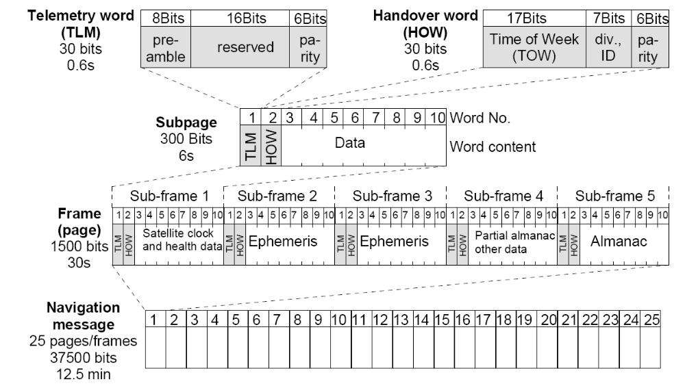
Navigation Message
Notes:
The navigation message from the satellite is transmitted at a glacial 50 bits per second. This means it takes 12.5 minutes to transmit the whole thing. What is inside the navigation message? The GPS system time, precise orbital data for the satellite (known as ephemerides), coarse orbital data for other satellites (known as the almanac).

Slide 16
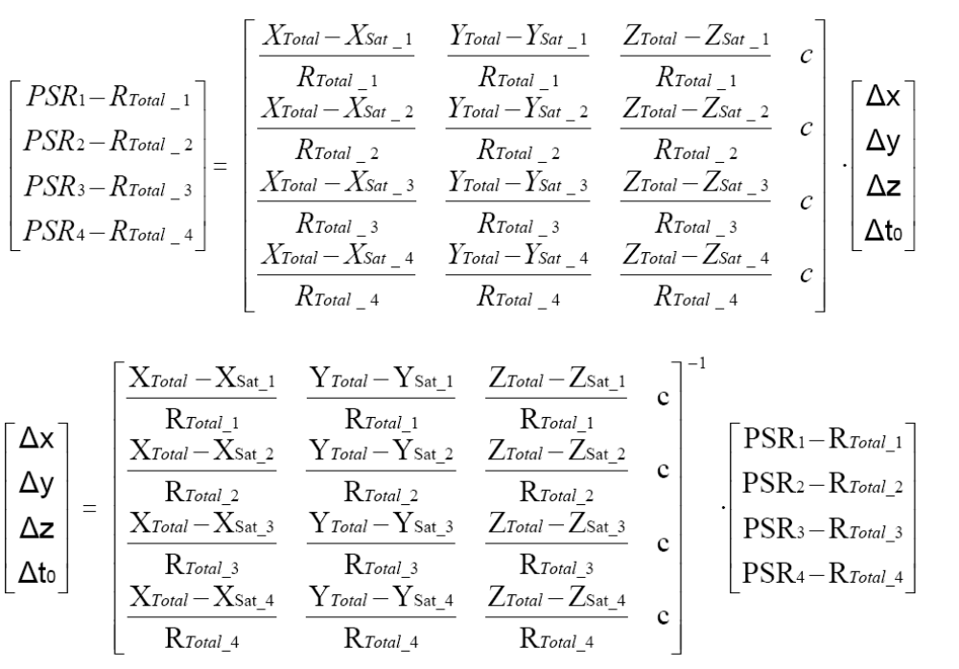
Navigation Solution
System of linear equations with four unknowns
Notes:
There’s math. Pretty picture to follow.

Slide 17
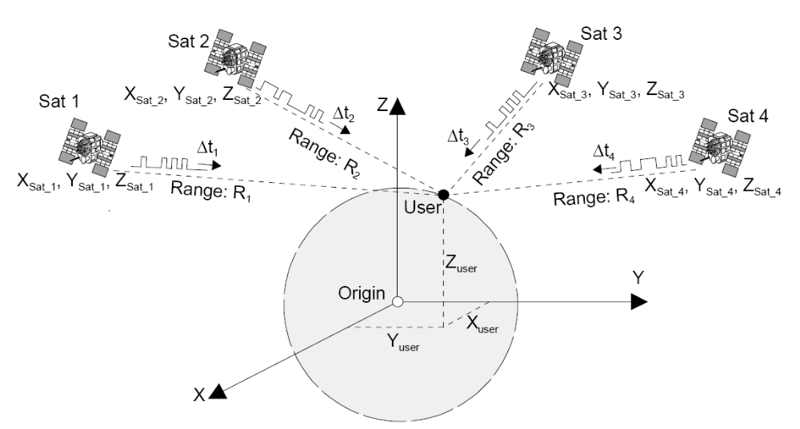
Navigation Solution
Notes:
With the navigation message, you can put the satellite at a position in space, calculate the range to the satellite, and figure out your position. This gives you the navigation solution!

Slide 18
Remember This?
GPS
Power
Latitude
Longitude
Altitude
Antenna
Notes:
This was the black box approach that we had shown earlier. We can do better than this.

Slide 19
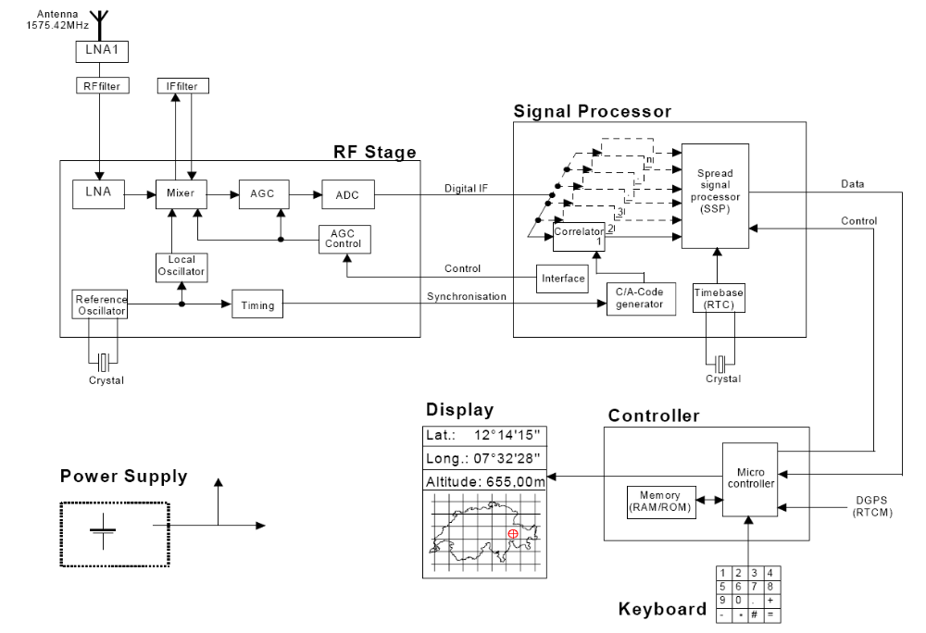
Less of a Black Box
Notes:
Here we are again. Let’s start with something simple. There is the power supply. Here is the RF stage. The 1.5 GHz GPS signal comes through a low noise amplifier and a filter. It is sent through another LNA and then to a mixer which downshifts it to an intermediate frequency (IF). The signal is filtered around the IF and then sent though an amplitude gain control and then an analog to digital converter (ADC). The digital IF is sent through to the GPS baseband processor. The one in this diagram has n channel correlators which sweep through Doppler shifts and C/A code phases until it locks into the GPS signal. The signal is passed through the signal processor which outputs the navigation message to the controller. The controller calculates the system time, position, velocity and other GPS products and outputs the GPS navigation solution. In this case, the solution is sent to a display.

Slide 20
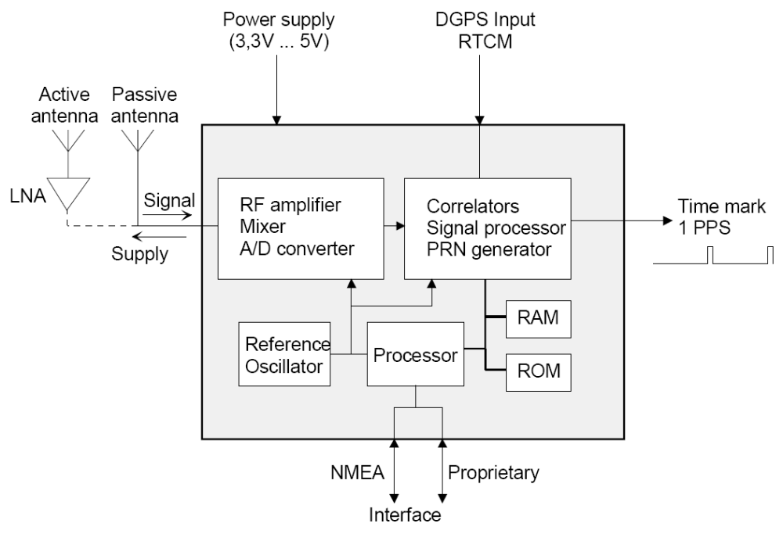
GPS Integrated Receiver Module
Notes:
So, a typical COTS receiver will have an active or passive antenna, a power supply, possibly a Differential GPS input, and it will output a 1 pulse per second timing signal and navigation solutions either in NMEA protocol or a proprietary protocol.

Slide 21
Current Solution
RF Front End
GPS Baseband
RF Components
LNA, IF mixer, ADC
DSP Components
Correlators, RTC
GPS Components
Navigation Solution
LCD or PC
Memory
User
Position Display
Storage
Data Logging
Notes:
This is a block diagram showing how COTS GPS modules work today.

Slide 22
Overview
Official Use Only
Project Motivation
  Concept Study of Extreme Low Power Consumption Context Aware GPS Receiver with Software Processing
Areas of Study
  RF hardware miniaturization and integration
  Context aware power management for low consumption
  Very short duration GPS snapshot acquisition
  Incomplete GPS fragment navigation
  Cross platform GNSS operation (GPS, Galileo)
Project Requirements
  Target Platform: NESDAC Stack Architecture
  Time Constraint: March 25, 2010

Slide 23
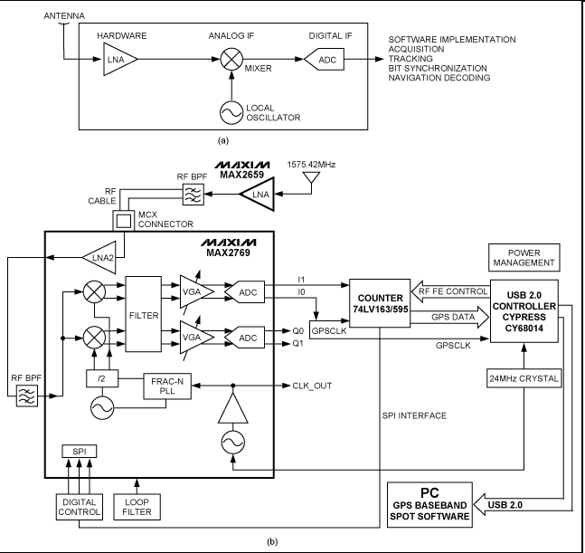
RF Hardware Miniaturization
“Software” GPS receiver
  Correlations and navigation done on PC
RF signal amplified through LNA, mixed to IF, sampled with ADC
MAX2769 solution sends data through USB 2.0 to software running on a PC
Notes:
Interesting proposal by Maxim IC has a software GPS receiver where the correlations and navigation solution calculations are offloaded to a PC.

Slide 24
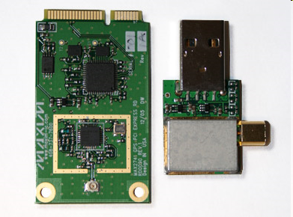
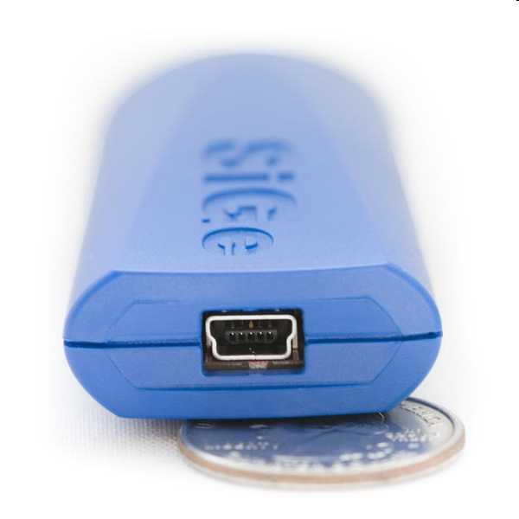
Software GPS Solution
RF Front End
GPS Baseband
PC
Display
RF Components
LNA, IF mixer, ADC
DSP and GPS Components
Correlators, RTC, Nav
User
Position Display
Notes:
The solution can be calculated and displayed on the PC, and all you need is a small USB dongle to get real time GPS navigation. Your PC is essentially turned into a giant GPS unit.

Slide 25
Proposed GPS Solution
RF Front End
Memory
GPS Baseband
RF Components
LNA, IF mixer, ADC
Storage
Data Logging
DSP and GPS
Correlators, RTC, Nav
GPS Baseband
PC
Display
DSP and Components
Correlators, RTC, Nav
User
Position Display
Notes:
Optionally, switch between onboard GPS processing and offboard GPS processing.

Slide 26
Areas of Investigation
Reduce “GPS receiver” to RF front end
  RHCP antennas
Capture samples only when necessary
  Triggered by accelerometer movement, other sensors, or RTC
Capture and store GPS RF data to memory in very quick snapshots
Process incomplete GPS snapshot and integrate with known stored GPS ephemerides to calculate position

Slide 27
Project Status and Path Forward
Hardware prototype developed by last year’s team.
  Revise the design and fabricate a new board
  PCB design tools, steps from design through testing
Embedded programming
  Architecting/writing code for on-board microcontroller
  Take samples, store in memory, download to PC
Software design
  Process GPS samples to determine board locations
  Map samples to user interface on PC

Slide 28
Overview
Official Use Only
Project Motivation
  Concept Study of Extreme Low Power Consumption Context Aware GPS Receiver with Software Processing
Areas of Study
  RF hardware miniaturization and integration
  Context aware power management for low consumption
  Very short duration GPS snapshot acquisition
  Incomplete GPS fragment navigation
  Cross platform GNSS operation (GPS, Galileo)
Project Requirements
  Target Platform: Sandia Stack Architecture
  Time Constraint: March 25, 2010

Slide 29
Estimated Dates
Project Kickoff (September 4)
Preliminary Design Review (September 29)
  After Career Fair (3:30)
Critical Design Review (December 12)
Technical Open House (March 25)
  Demonstration

Slide 30
Project Phases*
Phase I
  Get acclimated with theory of GPS and hardware
  Review results from last year
  Develop project plan for the year
Preliminary Design Review
Phase II
  Revise/fabricate PCB for RF and digital components
  Program microcontroller for power management, data storage, and USB interfaces
  Calculate GPS navigation solutions
Critical Design Review
Phase III
  Integration, testing, and validation
System Verification Review
Technical Open House

Slide 31
Preliminary Design Review*
Objectives
  Propose and present the project
  Convince audience of feasibility given constraints of time, effort, and materials
  Demonstrate project has appropriate complexity
PDR should address the following
  Outline of approach: block diagrams, ideas for architecture
  Implementation of subsystems: how to realize
  Division of labor, responsibilities, communication
  Schedule: project milestones
  Risks: areas of risk, mitigation plans
Should be able to answer questions like:
  What does the system do?
  What does it look like?
  How will it be used?

Slide 32
Critical Design Review*
Objectives
  Present the design of the system and how it will be implemented
  Ideas should be concrete at this point, moving out of prototype stage (85%)
CDR should address the following
  Block diagrams with functional description of parts and interfaces
  Layout of circuit boards, parts, and mechanical interfaces
  Complete specification of subsystems: circuit, logic diagrams, pinouts, interfaces with other systems
  Test results and demonstrations of completed parts of the system
  Parts list, bill of materials
Should be able to answer specific questions:
  How much power does it consume?
  How much space does it occupy?
  How much does it cost?

Slide 33
Contact Information
Steven Paradise
  sparadi@sandia.gov
  925.294.2755
Patrick Schindler
  pschind@sandia.gov
  925.294.2138

Slide 34
Where do we go from here?
Weekly status reports
  Simple memos, don’t get bogged down in bureaucracy
  Progress, decisions, what each person did
  What you need from us
Define project and prepare for CDR
  Open discussion with your group and with us
  Minimum requirements:
    Sandia stack form factor
    Low power device
    GPS logging

Slide 35
Interesting Links
http://gps.aau.dk/softgps/receiverTechnologyPart3.htm
http://www.sparkfun.com/commerce/categories.php?c=4
http://www.cadsoft.de/
http://www.pcb123.com/
http://focus.ti.com/mcu/docs/mcugettingstarted.tsp?sectionId=97&familyId=4
http://cegt201.bradley.edu/projects/proj2008/gps/Deliverables/Deliverables.htm
http://www.gps-sdr.com/

Slide 37
Old slides

Slide 38
Possible Routes for RF Front End
SiGe GN3S Sampler V2
  Hardware highly integrated into USB stick (one on order, arriving soon)
  MATLAB software package already available
  Textbook available: A Software-Defined GPS and Galileo Receiver: A Single-Frequency Approach
Maxim MAX2769 Universal GPS Receiver
  Development board in hand
  Samples are easy to acquire
  Gerber files and schematics available
Rakon GRM7520
  Miniaturized single channel GPS receiver
  Built in LNA, SAW filter, IF filter, TCXO
  May be difficult to acquire samples for testing

Slide 39
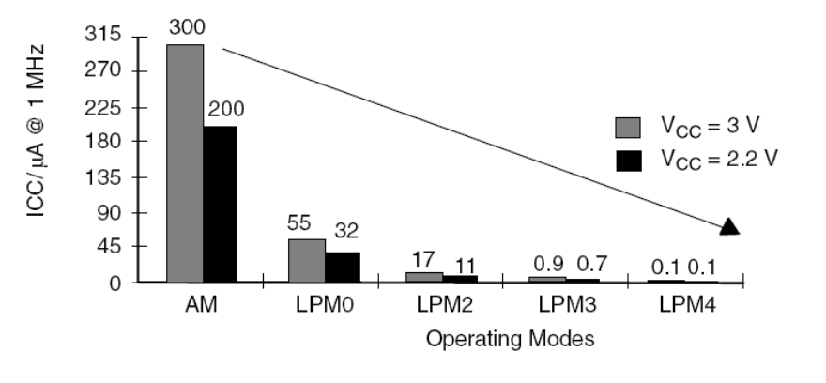
Suggestions for Microcontrollers
MSP430 known as a low power microcontroller
  LPM3 uses barely any power
Toolchains are well established
  Eclipse style IDE and debugger

Slide 40
Incomplete GPS Acquisition Approaches
Recent research has moved toward GPS snapshots!
  TIDGET (telemetry relay for missiles)
  GeoTate (geotagging for cameras, hot-shoe drop-in)
  A-GPS (ephemerides broadcast from cell network)
  10 mJ per capture
Also, Galileo GNSS system is coming online soon.

Slide 41
Possible Route
For example, project flow could be something like:
  Reverse engineering the SiGe USB stick
  Source the SE4110 chip, design to Sandia PCB layout
  Integrate MSP430 with on-board RTC and accelerometer to trigger GPS readings
  Log data to Flash or EEPROM chip
  Read out through USB with a USB UART (CP2102)
  Modify the MATLAB source to retrieve SV ephemerides
  Calculate recorded positions and display on map

